Slide 1
TEMA 1
LA LENGUA COMO COMUNICACIÓN: LENGUAJE ORAL Y LENGUAJE ESCRITO. FACTORES QUE DEEFINEN UNA SITUACIÓN COMUNICATIVA: ENISOR, RECEPTOR, FUNCCIONALIDAD Y CONTEXTO.

Slide 2
TABLE OF CONTENTS
1. LANGUAGE AS COMMUNICATION.
    1.1.Language definitions
    1.2.Language functions
    1.3.Communicative competence
  2. SPOKEN AND WRITTEN LANGUAGE
    2.1.Historical attitudes
    2.2.Spoken language
    2.3.Written language
    2.4.Differences between writing and speech
  3. COMMUNICATION THEORY
  3.1. Communication definition
  3.2. Shannon and the Communication Theory
  3.3. Key factors

Slide 3
1. LANGUAGE AS COMMUNICATION
1. LANGUAGE AS COMMUNICATION.
    1.1.Language definitions
    1.2.Language functions
    1.3.Communicative competence

Slide 4
1. LANGUAGE AS COMMUNICATION: 1.1.Language definitions
1.1. Language definitions (definition+ language properties)
Innumerable definitions
Focus on the general concept of the language (lenguaje).
“A language is a system of arbitrary vocal symbols by means of which the members of a society interact in terms of their total culture” Trager (1949)
Focus on the more specific notion of a language (idioma).
“The institutions whereby humans communicate and interact with each other by means of habitually used oral/auditory arbitrary symbols” Hall (1964)

Slide 5
1. LANGUAGE AS COMMUNICATION: 1.1.Language definitions
Properties of language (differentiate human language from all other form of signalling and make it a unique type of communication):
  COMMUNICTIVE VERSUS INFORMATIVE
  DISPLACEMENT
    can refer to past and future time, and to other locations.
  ARBITRARINESS
    No natural connection between a linguistic form and its meaning
  PRODUCTIVITY
    Novel utterances are continually being created.
  CULTURAL TRANSMISSION
    The process whereby language is passed from one generation to the next.
  DISCRETENESS
    The sounds used in a language are meaningfully distinct.
  OTHER PROPERTIES > not unique
    The use of vocal-auditory channel
    Reciprocity
    Specialisation
    Rapid fading
THE CORE FEATURES OF HUMANE LANGUAGE

Slide 6
1. LANGUAGE AS COMMUNICATION: 1.2.Language functions
1.2. Language functions (What language is for?)
Outline the main functions of language (Jakobson)
Group these functions into three metafunctions (Halliday)

Slide 7
1. LANGUAGE AS COMMUNICATION: 1.2.Language functions
Language functions (Jakobson):
  REPRESENTATIONAL FUNCTION (a message the context)
    it’s a leading task of numerous messages.
  EXPRESSIVE/EMOTIVE FUNCTION (a message the speaker)
    a direct expression of the speaker’s attitude toward what he is speaking about.
  CONATIVE FUNCTION (a message the addressee)
    it finds its purest grammatical expression in the vocative and imperative.
  PHATIC FUNCTION (a message the channel)
    refers to the social function of the language: basic human need to signal friendship.
  METALINGUAL FUNCTION (a message a code in which messages are formulated)
    Refers to the use of language to speak about language itself.
  POETIC FUNCTION (a message itself)
    Focuses on the message for its own sake (rhetorical figures, pitch, tone, loudness, etc.)

Slide 8
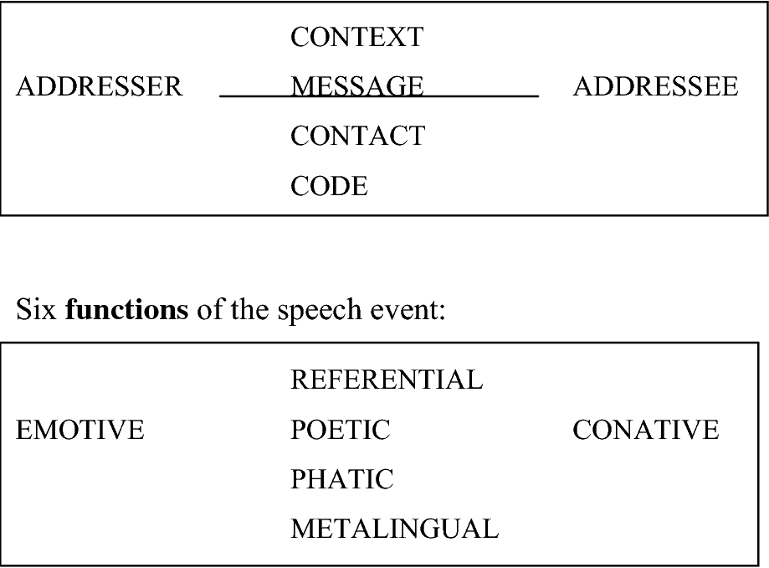
1. LANGUAGE AS COMMUNICATION: 1.2.Language functions

Slide 9
1. LANGUAGE AS COMMUNICATION: 1.2.Language functions
Halliday grouped these five functions into 3 metafunctions:
Ideational:
  to organize the addresser’s experience of the real or imaginary world. This is the use of language to express content and to communicate information.
Interpersonal:
  to indicate, establish, or maintain social relationships among people. The interpersonal function of language is reflected in the kind of social talk that we participate in throughout the day in conversational exchanges with family, friends, colleagues, etc.
Textual:
  to create written or spoken texts which cohere within themselves and fit the particular situation in which they are used. Halliday’s textual function is an intrinsic function of language, which makes it possible to use language to create text—any text.

Slide 10
1. LANGUAGE AS COMMUNICATION: 1.3.Communicative Competence
The concept of COMMUNICATIVE COMPETENCE:
FIRSTLY INTRODUCED BY CHOMSKY (1957)
Defined the language as a “set of sentences, each finite in length and constructed out of a finite set of elements”.
An able speaker has a subconscious knowledge of the grammar rules of his language which allows him to make sentences in that language (COMPETENCE).
HYMES
Argued that Chomsky had missed the rules of use.
Replaced Chomsky’s notion of COMPETENCE with the concept of COMMUNICATIVE COMPETENCE:
  Systematic potential (a native speaker possesses a system that has a potential for creating a language).
  Appropriacy (what language is appropriate in a given situation).
  Occurance (how often something is said in the language)
  Feasibility (whether something is possible in the language)/

Slide 11
1. LANGUAGE AS COMMUNICATION: 1.3.Communicative Competence
DEVELOPED BY CANALE AND SWAIN (1980)
COMMUNICATIVE COMPETENCE =
GRAMMATICAL COMPETENCE (grammar rules) + SOCIOLINGUISTIC COMPETENCE (the rules of language use).
The four components of communicative competence (CANALE):
Grammatical competence
  Producing a structured comprehensible utterances
Sociolinguistic competence
  Involving knowledge of the sociocultural rules of language and discourse
Discourse competence
  Communicating in different genres, using cohesion and coherence
Strategic competence
Enhancing the effectiveness of communication and compensating for breakdowns in communication

Slide 12
1. LANGUAGE AS COMMUNICATION: 1.3.Communicative Competence
SAVIGNON (1983) described how these four components interact .
“Communicative competence is a dynamic rather than a static concept. It depends on the negotiation of meaning between two or more persons who share to some degree the same symbolic system. In this sense, communicative competence can be said to be an interpersonal rather than intrapersonal trait.”
In the context of language teaching, the term COMMUNICATIVE COMPETENCE generally refers to the ABILITY TO PERFORM OR COMMUNICATE.
The concept is also present in our educational system.
The Organic Law of Education 2/2006 highlights the development both oral and written skills in the primary education. I

Slide 13
2. SPOKEN AND WRITTEN LANGUAGE
  2. SPOKEN AND WRITTEN LANGUAGE
    2.1.Historical attitudes
    2.2.Spoken language
    2.3.Written language
    2.4.Differences between writing and speech

Slide 14
  2. SPOKEN AND WRITTEN LANGUAGE
  2.1. Historical attitudes
Written language was traditionally considered to be superior to spoken language.
    Literature was considered a source of standards of linguistic excellence
    The rules of grammar were illustrated exclusively from written texts
    Spoken language was ignored as an object unworthy of study
    The central point was that spoken language lacked of care and organization.
A group of linguists argued in favour of studying speech as the primary medium of communication
    Written language as a tool of secondary importance
    Writing came to be excluded from the primary subject matter of linguistic science.
Nowadays, there is no sense in the view that one medium of communication is intrinsically better.
    Writing cannot substitute for speech, nor speech for writing.

Slide 15
2. SPOKEN AND WRITTEN LANGUAGE
2.2. Spoken language
Definition of speech.
  Speech is the universal material of human language.
  Phonetics: description and classification of speech sounds:
    Articulatory phonetics
      production of sounds
    Acoustic phonetics
      transmisson of speech sound waves
    Auditory phonetics
      the hearing process, the reception of speech sound waves.

Slide 16
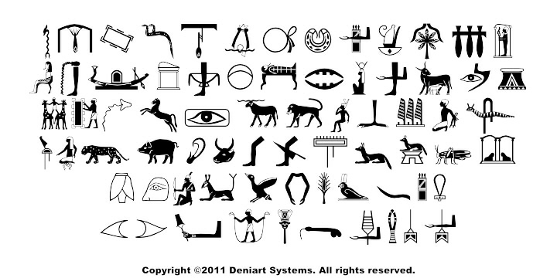
2. SPOKEN AND WRITTEN LANGUAGE
2.2.Written language
Two types of writing can be established:
  Non-phonological systems
    No clear relationship between the symbols and the sounds of the language.
    They include the pictographic, ideographic, cuneiform and Egyptian hieroglyphic.

Slide 17
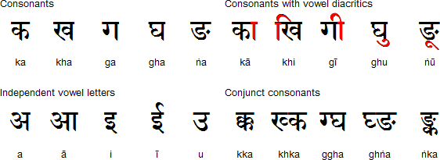
2. SPOKEN AND WRITTEN LANGUAGE
2.2.Written language
  Phonological systems
    Show a clear relationship between the symbols and the sounds of the language.
    Can be distinguished between syllabic systems and alphabetic systems.

Slide 18
2. SPOKEN AND WRITTEN LANGUAGE
2.2.Difference between writing and speech.
The differences between spoken and written language. Holtgraves (2002)
  Spoken language mode features:
    Grammatical features
      Ellipsis, abbreviation of verbs, the ability for phrases, high incidence of coordinated clauses, active verb forms, etc.
    Lexical features
      Low lexical density, less abstract vocabulary, more generalised and simpler vocabulary, semantically empty prefabricated “fillers”, etc.
    Discourse features
      More than 1 participant, markers of interpersonal dynamics, repetition and echoing between speakers, etc.

Slide 19
2. SPOKEN AND WRITTEN LANGUAGE
2.2.Difference between writing and speech.
  The differences between spoken and written language. Holtgraves (2002)
  Written language mode features:
    Grammatical features
      Full phrases and clauses with little abbreviation and less ellipsis, standard grammar, longer and more complex clauses, densely informative noun phrases, etc.
    Lexical features
      High lexical density, complex vocabulary and the use of more abstract terms with a higher incidence of words of Greek and Latin origin, grater variety in choice of vocabulary with lower levels of repetition.
    Discourse features
      Explicit presentation of idea to a non-present audience, few markers of interpersonal discourse, explicit indication of text organization.

Slide 20
3. COMMUNICATION THEORY
  3. COMMUNICATION THEORY
  3.1. Communication definition
  3.2. Shannon and the Communication Theory
  3.3. Key factors

Slide 21
  3. COMMUNICATION THEORY
  3.1. Communication definition
Communication, exchange of meanings between individuals through a common system of symbols, concerned scholars since the time of ancient Greece.
    Since 1920s the growth of communications technology led to the attempt to isolate communication as a specific facet.
    In the 1960s - Marshall Ms Luhan’s idea “the medium is the message” stimulated many filmmakers and photographers.
    The late XXth century – the main focus of interest in communication – drifting away from McLuhanism and to be centering upon:
        The mass communication industries
        Persuasive communication and the use of technology to influence dispositions
        Processes of interpersonal communication as mediators of information
        Dynamics of verbal and non-verbal communication between individuals
        Perception of different kinds of communication
        Uses of communication technology for social and artistic purposes.

Slide 22
3. COMMUNICATION THEORY
3.2. Shannon and the Communication Theory
Most communication theorists admit that their main task is to answer the query:
  Who
  Says What
  In Which Channel
  To Whom
  With What Effect?“ (Lasswell, 1948)

Slide 23
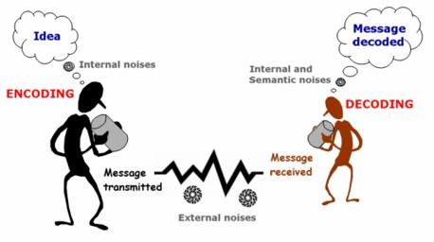
3. COMMUNICATION THEORY
3.2. Shannon and the Communication Theory
1940s – Claude Shannon invented a mathematical theory of communication that gave the first systematic framework in which to optimally design telephone systems.
Shanonn’s communication channel consisted of a sender, a transmission medium, and a receiver.

Slide 24
3. COMMUNICATION THEORY
3.2. Shannon and the Communication Theory
The concept of ENTROPY RATE /is the average amount of information contained in each message received
Two mechanisms aimed at countering the potential failures in the communication process:
  Negative entropy
      incomplete or blurred messages are received intact due to the ability of the receiver
  Redundacy
      Repetition of elements within a message

Slide 25
3. COMMUNICATION THEORY
3.3. Key factors
Two factors that that can condition any communicative situation: speech acts and the social context.
3.3.1 Austin’s (1962) Speech Act Theory
  PERFORMATIVE utterances
    Are used in order to perform some act, they are not amenable to a truth conditional analysis. (I promise).
  CONSTATIVE utterances
    A truth value could be determined .(It is raining.)

Slide 26
3. COMMUNICATION THEORY
3.3. Key factors
Later, Austin abandoned the performative/constative distinction in favour of a theory of illocutionary forces (speech acts).
Any utterance involves the simultaneous performance of a number of different acts.
  Locutionary acts
    First, one is performing a locutionary act, making certain sounds that comprise words with a certain sense. The locutionary act involves the traditional dimensions of language (phonetics, syntax, semantics).
  Illocutionary acts.
    Is the conventional force associate with uttering of the words in a particular context. (I promise to do it tonight / the illocutionary force of promise).
  Perlocutionary acts.
    Refers to the result or effect that is produced by means of saying something (such as persuading, convincing, scaring, enlightening, inspiring, or otherwise getting someone to do or realize something, whether intended or not).

Slide 27
3. COMMUNICATION THEORY
3.3. Key factors
Searl(1969) systematised and extended speech act theory in several directions. His most important contribution includes his taxonomy of speech acts.
According to Searl (1969), there are 5 basic, primitive illocutionary points:
  DIRECTIVES
    An attempt to get the hearer to perform some future actions (requesting, ordering, questioning)
  ASSETRTIVES
    An attempt to represent an actual state of affairs, to commit the speaker to something being the case (asserting, concluding, informing, predicting, reporting)
  COMISSIVES
    an attempt to commit the speaker to a future course of action (warning, promising, threatening, guaranteeing)
  DECLARATIVES
    An attempt to bring about a change in some institutional state of affairs (declaring of war, performing a marriage).
  EXPRESSIVES
    An attempt to express a psychological state (thanking, complaining, greeting, apologizing).

Slide 28
3. COMMUNICATION THEORY
3.3. Key factors
3.3.2. Context
Apart from speech acts, there is another factor that can condition any communicative situation: the context.
Context (the Collins English Dictionary):
1. the parts of a piece of writing, speech, etc., that precede and follow a word or passage and contribute to its full meaning.
2. the conditions and circumstances that are relevant to an event, fact, etc.

Slide 29
3. COMMUNICATION THEORY
3.3. Key factors
The 1st definition covers the linguistic context, and may refer not only to the other parts of the text, but also to the outside world.
REFERENCE
LINGUISTIC CONTEXT | CONTEXT OF SITUATION
ENDOPHORA | B.EXOPHORA
ANAPHORA to preceding text CATAPHORA to following text

Slide 30
3. COMMUNICATION THEORY
3.3. Key factors
The 2nd definition covers the context of situation.
  Malinowski /introduced the concept
  Hymes and Halliday / extended the concept
CONTEXT OF SITUATION
HYMES | HALLIDAY
Form and content of text. Setting. Participants. Ends. Key. Medium. Genre. Interactional norms. | Field. Mode. Tenor.

Slide 31
3. COMMUNICATION THEORY
3.3. Key factors
  The context of situation is the context in which the text unfolds.
  It is encapsulated in the text through a systematic relationship between the social environment and the functional organization of the language.
The features of the context of situation
The field of discourse: what is happening in terms of the nature of the social action that is taking place.
The tenor of Discourse: who is taking part, the nature of the participants, their status and roles.
The mode of Discourse: what part the language is playing: the symbolic organization, the status of the text, function, channel, the rhetorical mode.

Slide 32
Practice
Read the text and describe it in terms of the field, the tenor and the mode of discourse.
Text 1.
(from a radio talk by the Bishop of Woolwich)
The Christian should therefore take atheism seriously, not only so that he may be able to answer it, but so that he himself may still be able to be a believer in the mid-twentieth century. With this in mind, I would ask you to expose yourself to the three trusts of modern atheism. These are not so much three types of atheism – each is present in varying degree in any representative type – so much as three motives which have impelled men, particularly over the past hundred years, to question the God of their upbringing and ours. They may be represented by three summary statements:
God is intellectually superfluous;
God is emotionally dispensible;
God is morally intolerable.

